Slide 1




Searching for the Youngest Exoplanets
Jacob N. McLane
Northern Arizona University
Dr. Lisa Prato
Lowell Observatory

Slide 2
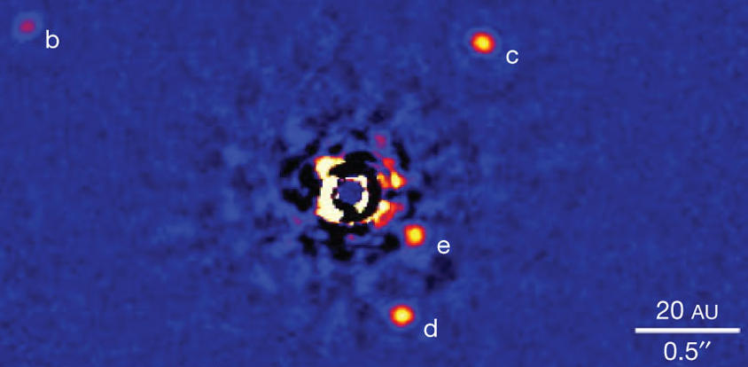
Our Project
Identifying Young (~2 Myr) Planet Hosts
Refine Planetary Formation and Evolution
Few examples of planets around young stars
  Most found through direct imaging
  Ages of 10’s of Myr
Radial Velocity (RV) Survey
Marois et al. 2008

Slide 3
Complications
Star formation regions are distant (>100 pc)
Faint, especially in visible wavelengths, because of extinction
Strong magnetic fields, massive starspots
Circumstellar disks

Slide 4
Solutions
Use longer integration times
Observe the targets at
multiple wavelengths

Slide 5
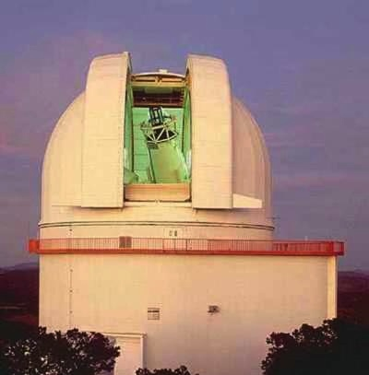
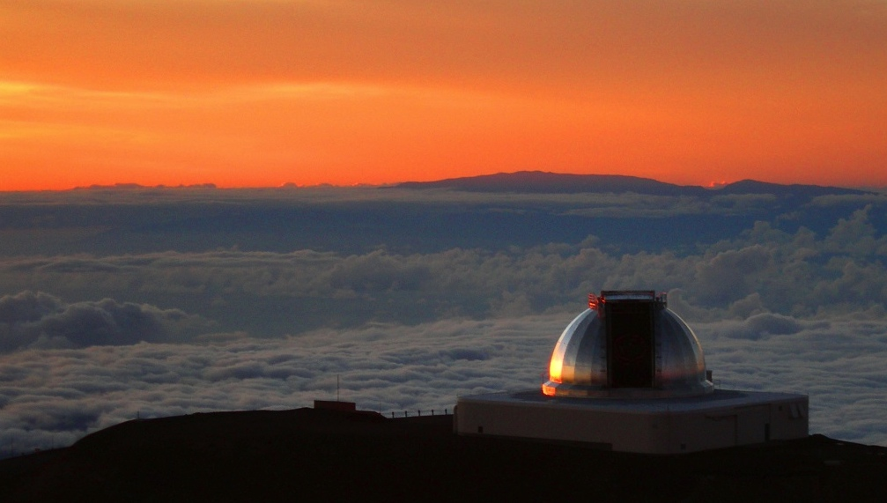
Data Gathering
2.7 Meter Harlan J. Smith Telescope at McDonald Observatory
Remote Observation with NASA Infrared Telescope Facility (IRTF)
Credit: Taylor S. Chonis
Credit: McDonald Observatory

Slide 6
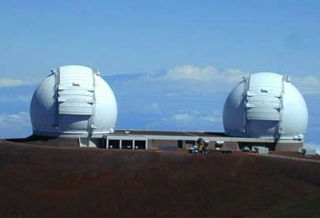
Data Reduction
Near Infrared Spectrograph (NIRSPEC) at Keck II
CSHELL at NASA’s IRTF
NIRSPEC data were reduced with REDSPEC
CSHELL data were reduced using code from Dr. Chris Crockett
Credit: W.M. Keck Observatory

Slide 7
Fitting Process

Slide 8
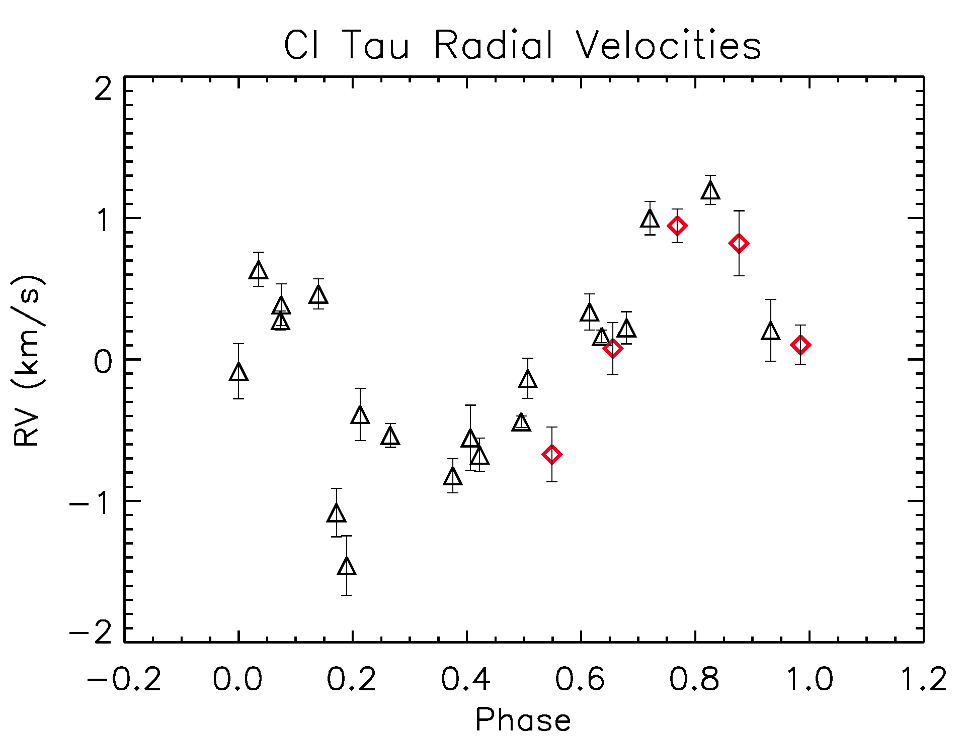
CI Tau
9.49329 Day Orbital Period

Slide 9
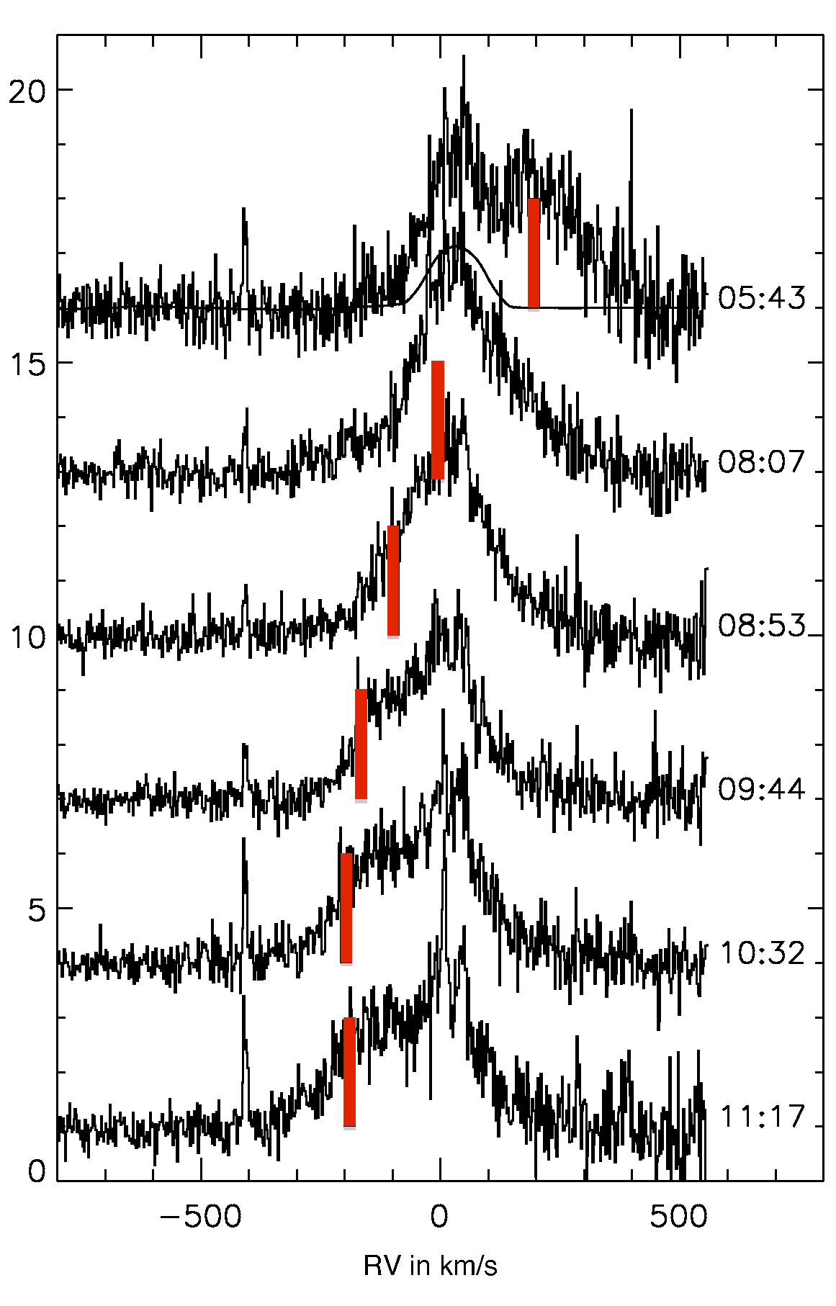
PTFO 8-8695
0.4 Day Orbital Period
van Eyken et al. 2012

Slide 10
Going Forward
Large amount of data still to be reduced
  Includes both host candidates and new targets
Continuing the survey

Slide 11
Acknowledgements
Dr. Christopher Crockett
Dr. Cristopher Johns-Krull
Wei Chen
NASA
Arizona Space Grant Consortium
NAU Space Grant
Dr. Lisa Prato

Slide 12
Questions?

